Slide 2

The Highlights

Slide 3






Team Highlights
Name | Location
Aanchal Lohia | Mumbai, India
Ravishekhar Gopalan | Toronto, Canada
Chetan Urkudkar | Dublin, USA
Pankaj Khairnar | Mumbai, India
Prashant Hattiholi | Pune, India

Slide 4
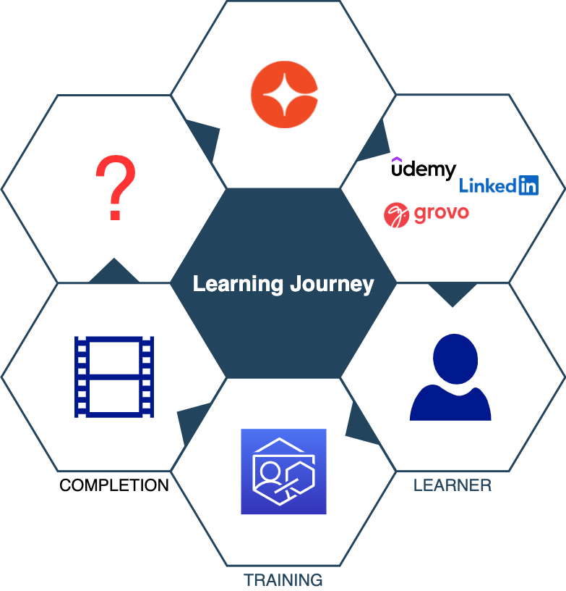
Learning Journey

Slide 5
Realization

Slide 6
Completion is a milestone!

Slide 7
Journey does not end here…
What about after the learner completes training ?
Learning does not end with completion of training
This hack enables us to continue the journey together with our learners
Notes:
We are Targeting areas that are known for having a lot of our customers and that have an average of over 25 attendees
Some early research Q1
The first 3-4 cities in Q1 will really be a test as I will reflect and evaluate how it went before, we move continue the Program in Q2 (we will still be advertising for these shows in Q2 while we evaluate what Q1’s results).
-There will be surveys at the user groups which will be the main data point as well as attendance.
Customers by location what do I want attendance wise (what %)

Slide 8
If you don’t use it, you lose it!
Theory

Slide 9
If you don’t use it
AND
switch contexts frequently,
you already lost it!
Reality

Slide 10
Value
Post training completion
Most often learners gradually lose what they learnt
Can we help learners reinforce their learning?

Slide 11
Retention
We can help learners retain what they have learnt
Widely-used technique – Spaced Repetition
Real world hacks
Highlight text in books/notes
Flashcards
Our hack provides functionality of both examples

Slide 12
Solution

Slide 13
Words of the wise…
Repetition
Reinforces
Retention

Slide 14
Demo

Slide 15
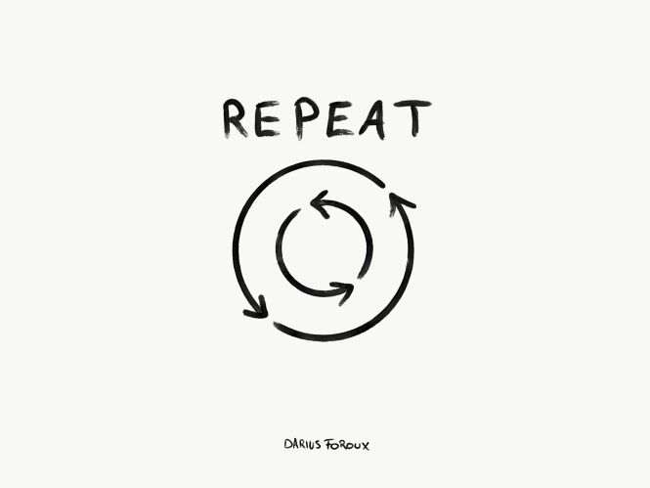


Reinforce
Repetition
Highlight portlet
Cycle through user’s highlights
Reinforcement
Jog memory
Support additional context
Retention
Increase knowledge lifetime
Increase engagement

Slide 16
Questions?
cornerstoneondemand.com
Team Highlights
highlights@csod.com

Slide 17
Thank You!

